Slide 1

ANALYSIS OF CHINESE FOOD PLACES IN ONTARIO, CANADA
DATA SCIENCE CAPSTONE PROJECT BY A.A NWAOKOLO

Slide 2
Introduction/Business Problem
All over the world Chinese cuisine has become very popular for people who want to hangout with friends, go on romantic dates or just grab quick take away. Ontario is Canada's second largest province,With a population of more than 13.5 million, having over 85% living in urban towns and people who love to enjoy the good things. In this project we would be analysing the different chinese food places in Ontario to show the most popular categories. There are several reasons people patronise chinese food. Some visit Chinese restarants for romantic dates while others want to grab quick fast food. The project is meant to highlight the most popular category of Chinese food in Ontario. We start by first getting a list of towns in Ontario and then details of Chinese food places with their categories and identify the most popolar categories.

Slide 3
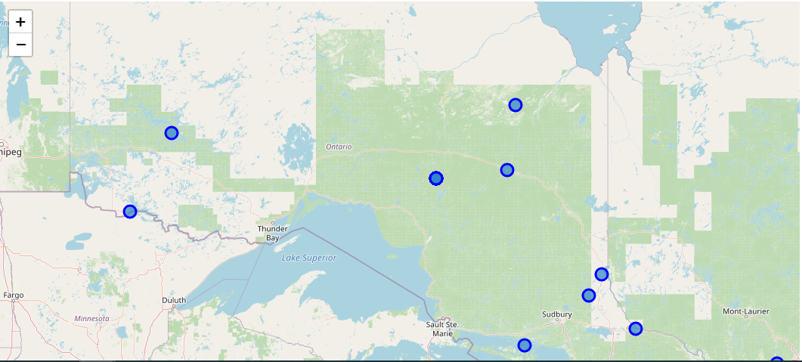
MAP OF ONTARIO

Slide 4
Data
For this project i used 'https://en.wikipedia.org/wiki/Category:Towns_in_Ontario' to get details of towns in Ontario for my analysis. I used Opencage geocode for my geographical coordinates. I also used foursquare API to get details of Chinese food places in Ontario.

Slide 5
METHODOLOGY
After getting a list of towns in Ontario, the next thing I did was to put them in a data frame so the list can be seen clearly.
I went ahead to import Opencage geocoder to sort out the towns with their longitudes and latitudes.
I got a dataframe showing the towns with latitudes and longitudes.
I imported folium, numpy, pandas, and matplotlib to assist with my visualization.
I created a map to show Ontario and its cities.
Using Foursquare I got a list of various food locations in Ontario and put them in data frame.

Slide 6
RESULTS
Results produces a list of chinese food places in ontario and a data frame is produced showing the different categories. Major Categories can be seen to be restaurants and pizza places.

Slide 7
DISCUSSION
Looking at Ontario and like mentioned earlier in the introduction , there are several reason why people patronise chinese food , either for hanging out with friends or going on romantic dates.
Major categories found show that pizza places are as popular as restaurants.

Slide 8
CONCLUSION
Ontario is Canada's second largest province,With a population of more than 13.5 million, having over 85% living in urban towns and people who love to enjoy the good things. In this project we have analysed the different chinese food places in Ontario to show the most popular categories. There are several reasons people patronise chinese food. Some visit Chinese restarants for romantic dates while others want to grab quick fast food. From this project we can say that the most popular categories are pizza places and resturants.

